Slide 1
CitiBike: Case for Last-Mile Connectivity in the NYC MTA System
By: Aanvi Goel

Slide 2
Overview
The Metropolitan Transport Authority serves as a daily ridership of more than 5 million and connects 472 subway stations
The commuters occasionally require a second mode of transportation to reach their destination, also known as the last-mile connectivity

Slide 3
Project objective:
Evaluate the viability of CitiBike to improve the last-mile connectivity for the MTA system

Slide 4
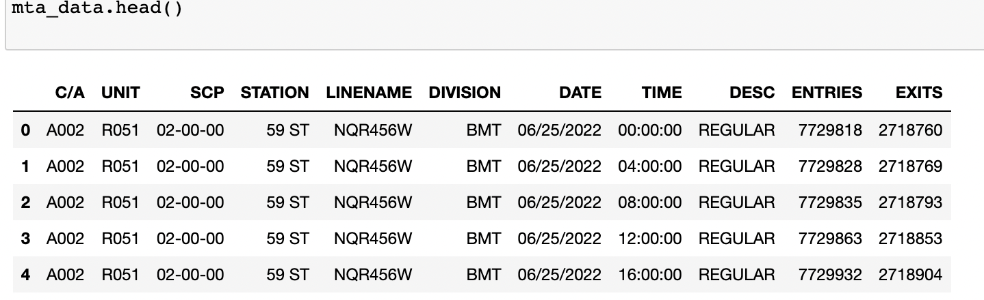
Understanding the data
MTA Turnstile Data

Slide 5
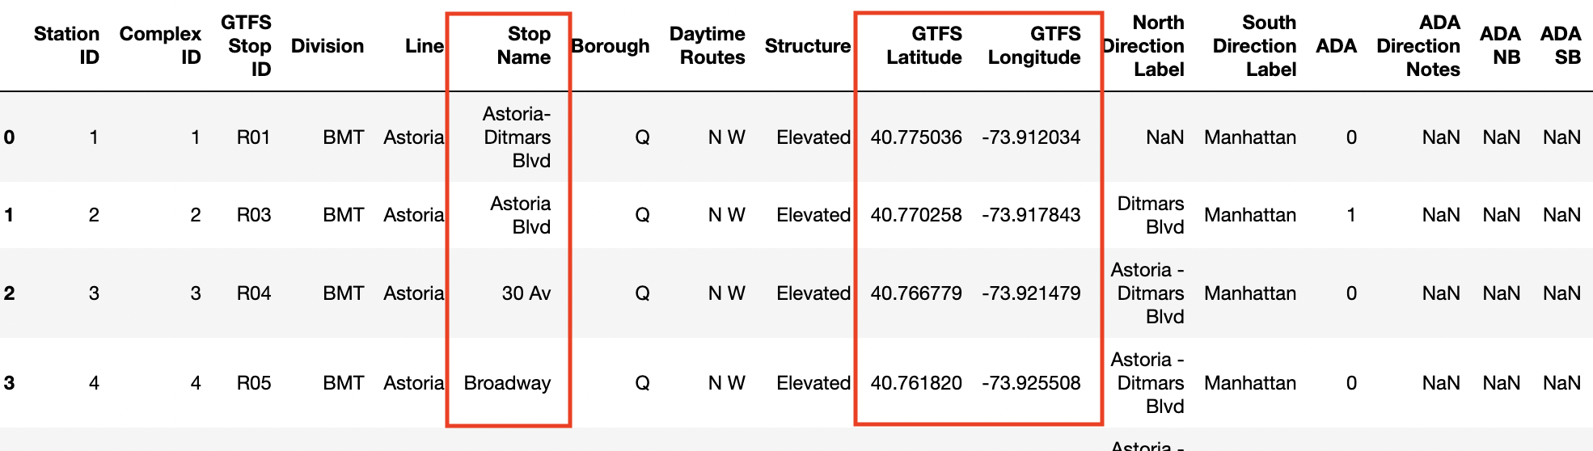
2. MTA Station Data

Slide 6
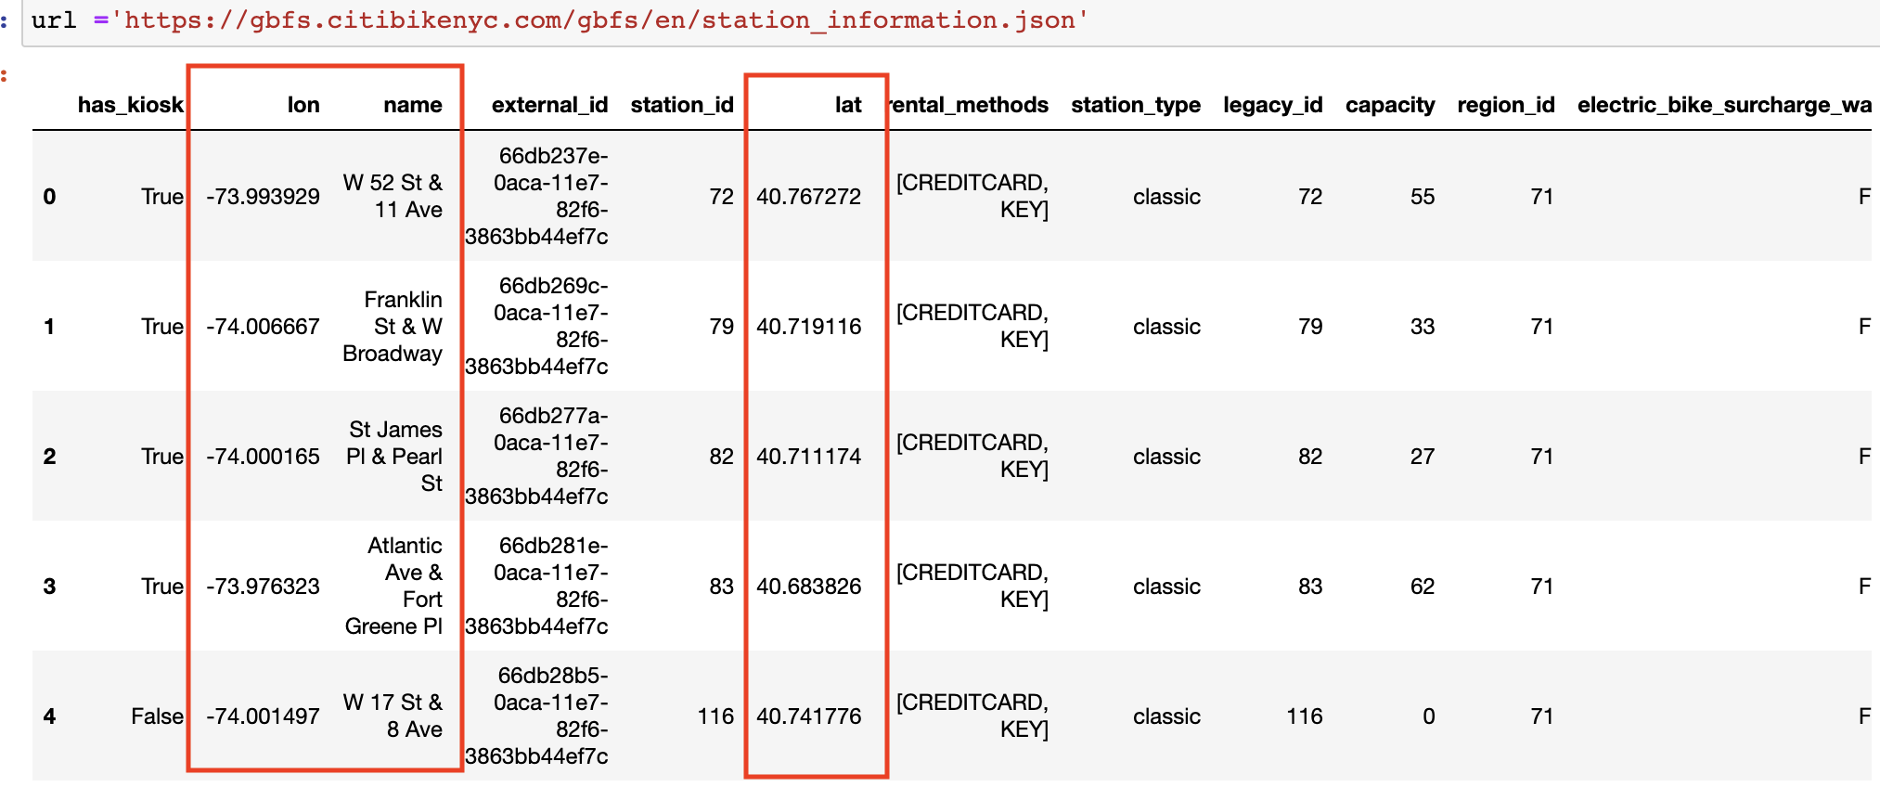
3. CitiBike Data

Slide 7
Methodology
Finding Nearest CitiBike Stations
Analyzing MTA Trends
Data Cleaning
Visualizing MTA Data

Slide 8
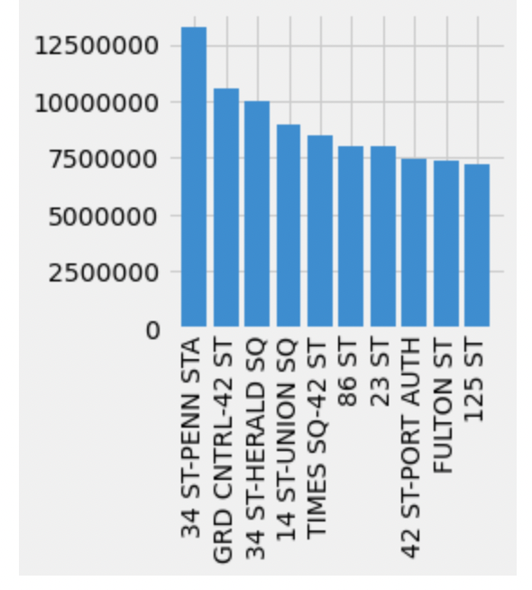
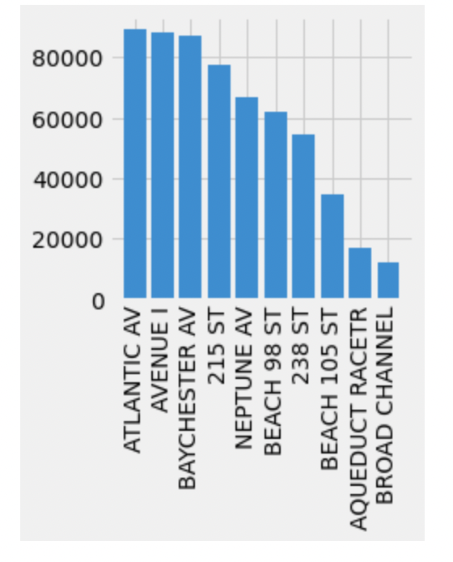
MTA Ridership Trends
Stations with Most Daily Exits
Stations with Least Daily Exits
Notes:
Most popular - 12.5 - 2.5 million
Least used - 80 - 20k

Slide 9
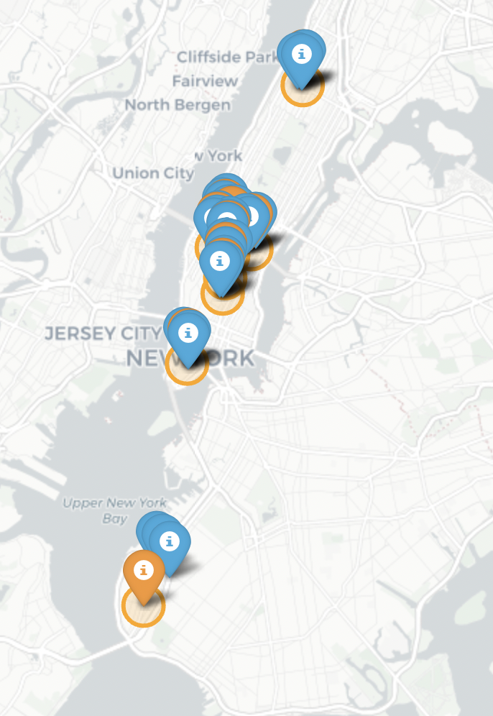
Visualizing Station Locations
Stations with Most Daily Exits
Setting the filter radius = 0.5 miles
MTA Stations are in Orange with a radius marker
The nearest CitiBike stations for each MTA station are plotted in Blue
Notes:
Most popular - 12.5 - 2.5 million
Least used - 80 - 20k

Slide 10
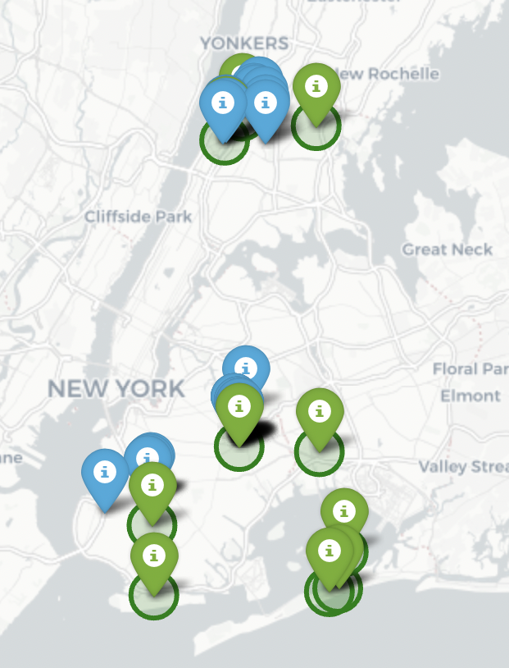
Visualizing Station Locations
Stations with Least Daily Exits
Setting the filter radius = 1 mile
MTA Stations are in Green with a radius marker
The nearest CitiBike stations for each MTA station are plotted in Blue
Notes:
Most popular - 12.5 - 2.5 million
Least used - 80 - 20k

Slide 11
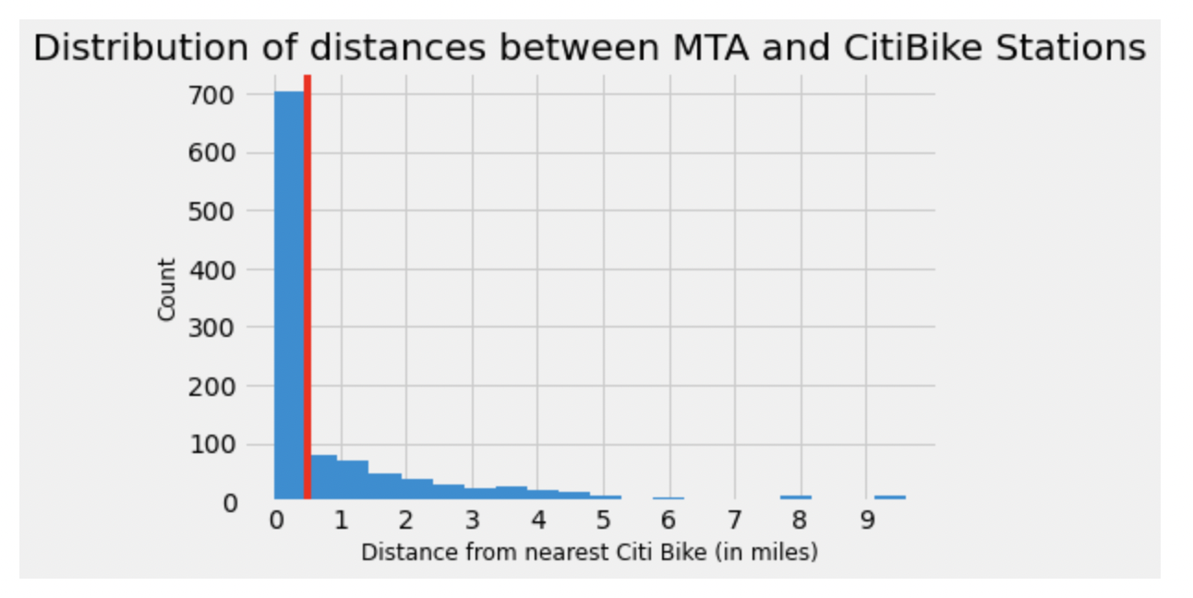
Spotlight: Stations with Least Daily Exits
Notes:
Most popular - 12.5 - 2.5 million
Least used - 80 - 20k

Slide 12
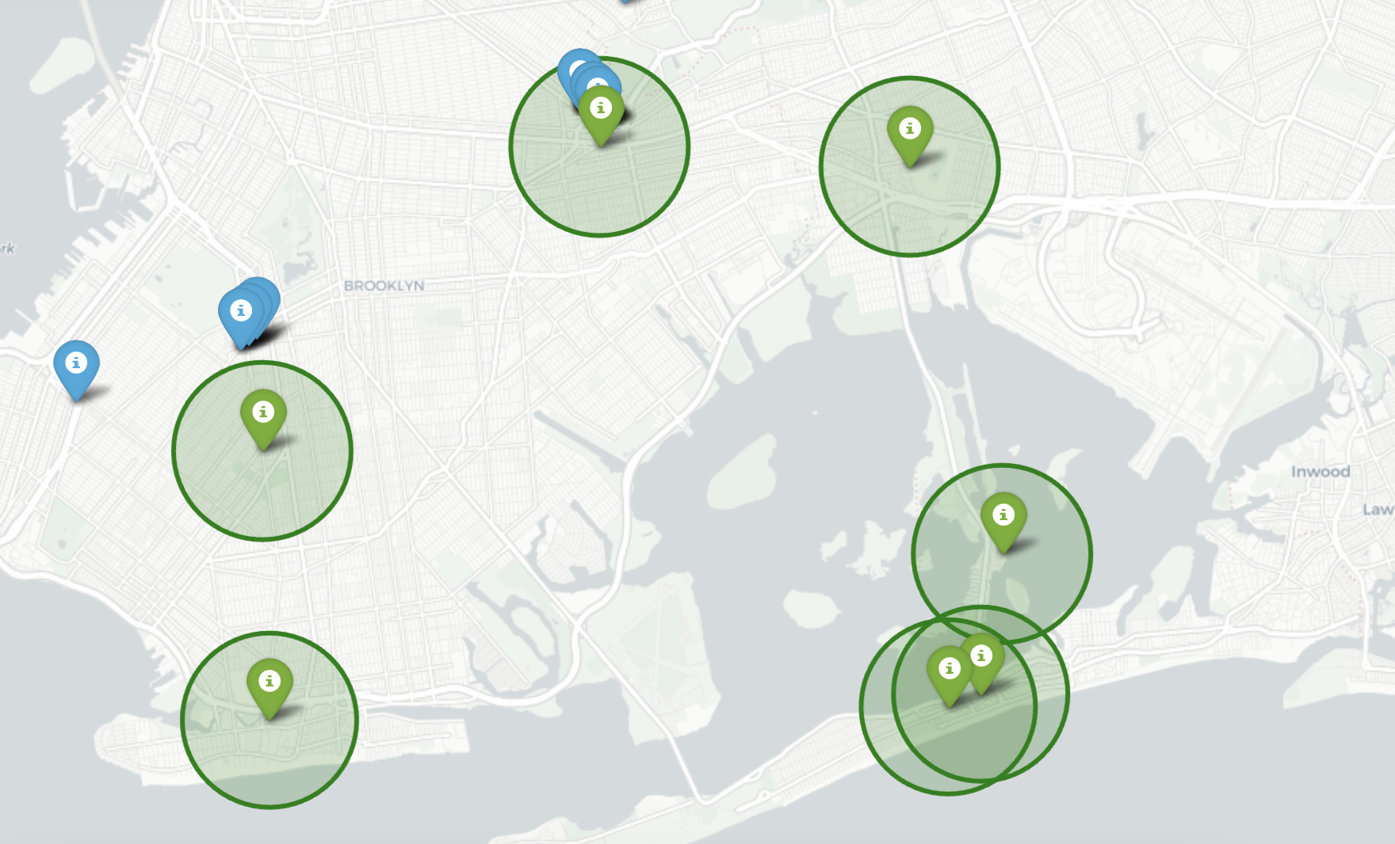
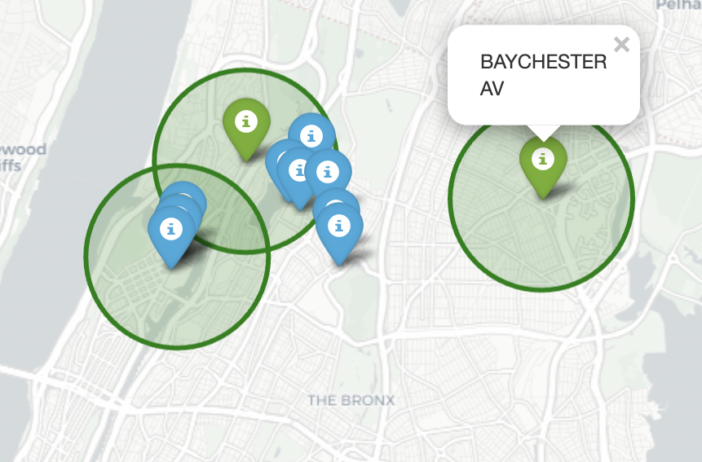
The Bronx
Brooklyn and Queens
Notes:
Most popular - 12.5 - 2.5 million
Least used - 80 - 20k

Slide 13
Conclusions
Areas further away from city-center, have fewer CitiBike stations
CitiBike Stations in boroughs such as Bronx, Brooklyn and Queens have >1 mile distance between the MTA stations and CitiBike stations
Recommendations
To improve the commuter experience and CitiBike ridership:
→ CitiBike should build new bike stations in low-presence areas such as Bronx, Brooklyn and Queens
→ For the areas with existing CitiBike stations, CitiBike should increase the number of stations to be within 0.5 miles of the MTA stations

Slide 14
Future Work
Analyze Citi Bike station/vehicle status data to analyze current bike availability per CitiBike station
This data can be combined with the analysis on MTA Station ridership improve capacity based on day of week & time of day
Link to CitiBike Data:
https://github.com/NABSA/gbfs/blob/master/gbfs.md#geofencing_zonesjson

Slide 15
APPENDIX

Slide 16
Data Cleaning Process:
Correcting negative counters
Removing rows with overflow counters as they were smaller in number and had minimal impact if dropped
#Based on the above data there are 2 anomalies - 1) Negative counters 2) Counter overflow
#Taking the abs of DAILIY EXIT values for the turnstiles that are counting in reverse
mta_daily_exits['DAILY_EXITS']=abs(mta_daily_exits.DAILY_EXITS)
#Since the numbers of rows with counter overflow is relatively low, I have decided to drop the rows with counts>5000
mta_daily_exits=mta_daily_exits[mta_daily_exits.DAILY_EXITS < 5000]
mta_daily_exits.DAILY_EXITS.describe()

Slide 17
Dropping the ‘bad’ counters - defined as counters which may have malfunctioned and did not increase count over the duration of days
Dropping data from TRAM between Manhattan st and Roosevelt Island St to only consider sunway data
#There are 2 stations for the Tram between Manhattan and Roosevelt Island. We'll also remove these two rows.
tram=mta_daily_exits['C/A'].isin(['TRAM1','TRAM2'])
mta_daily_exits=mta_daily_exits[~tram]

Slide 18
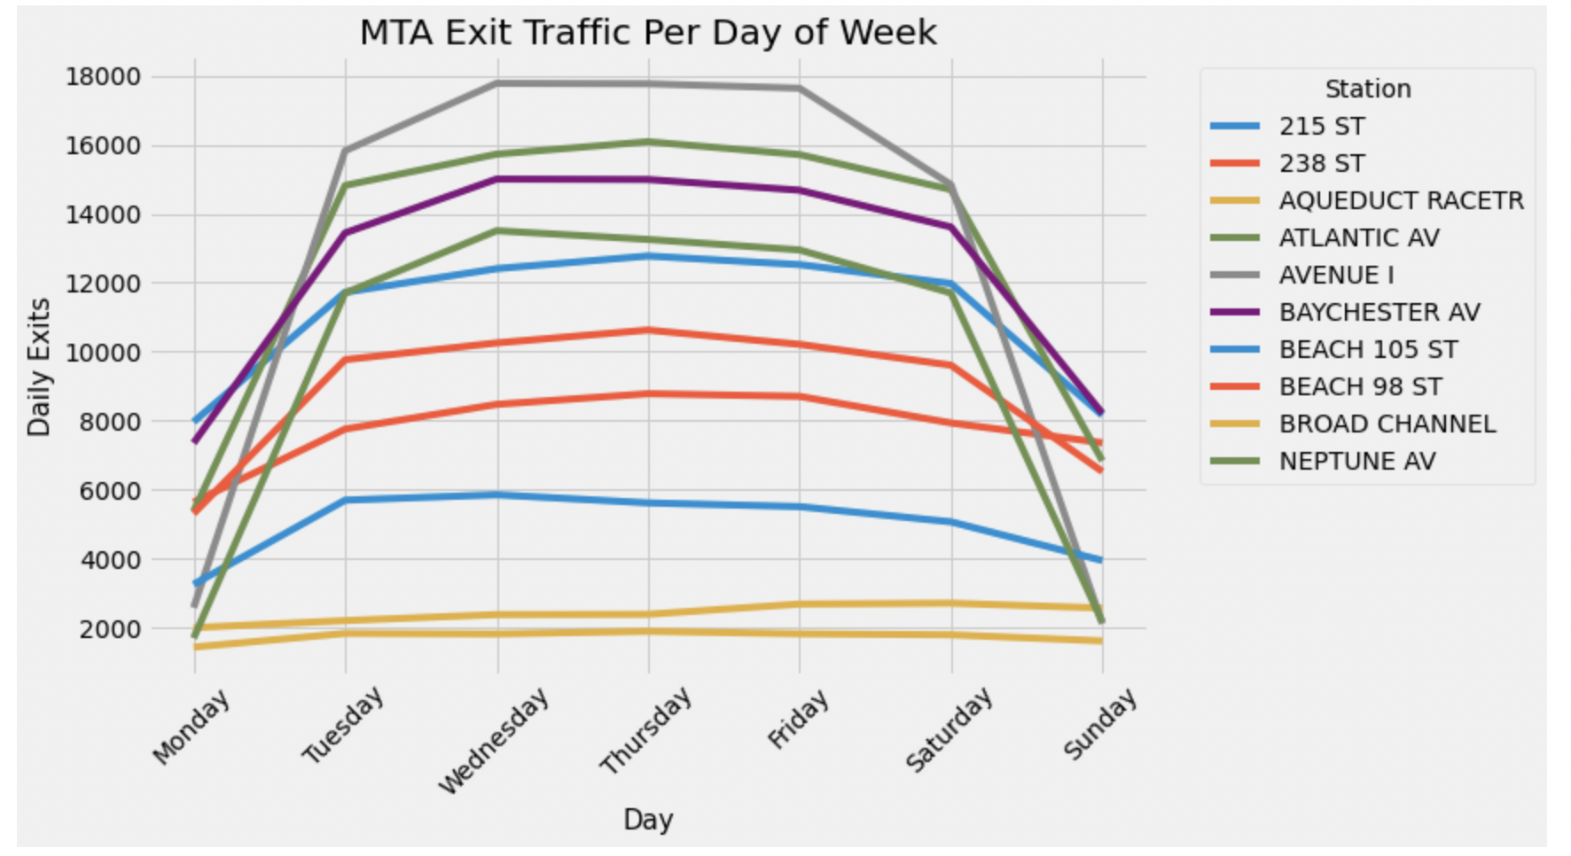

Slide 19
#Finding respective matches for STation names in the MTA Turnstile Data and the MTA Station Data using FuzzyWuzzy
https://www.geeksforgeeks.org/how-to-do-fuzzy-matching-on-pandas-dataframe-column-using-python/
match1 = []
match2 = []
p= []
list1 = station_to_date.STATION.tolist()
list2 = station_loc_data.STOP_NAME.tolist()
threshold = 50
for i in list1:
match1.append(process.extractOne(i, list2, scorer=fuzz.ratio))
station_to_date['MATCHES'] = match1
for j in station_to_date['MATCHES']:
if j[1] >= threshold:
p.append(j[0])
match2.append(','.join(p))
p= []
station_to_date['MATCHES'] = match2

Slide 20
#Creating an algorithm using the Haversine formula to find distances between MTA Stations and Nearest 3 CitiBike stations
import haversine as hs
from haversine import Unit
def get_distances(df1, df2):
dist_df=pd.DataFrame()
for i,row1 in df1.iterrows():
for j,row2 in df2.iterrows():
loc1 = [row1['LAT'], row1['LONG']]
loc2 = [row2['lat'], row2['lon']]
dist= hs.haversine(loc1,loc2, unit=Unit.MILES)
df2.at[j,'dist']=dist
df2.at[j,'station_name'] = row1['STATION']
dist_append= df2.sort_values(by=['dist'])[0:3]
dist_df=pd.concat([dist_df,dist_append], ignore_index=True)
return dist_df

